Slide 1
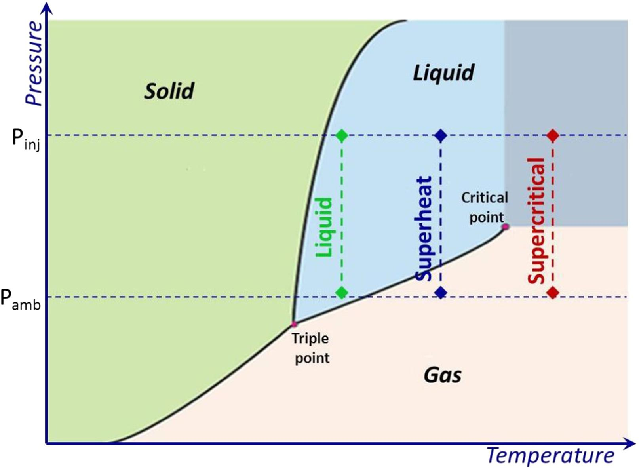
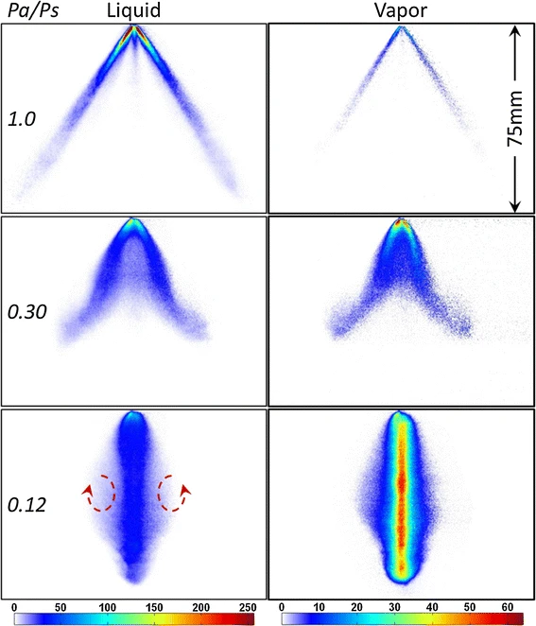
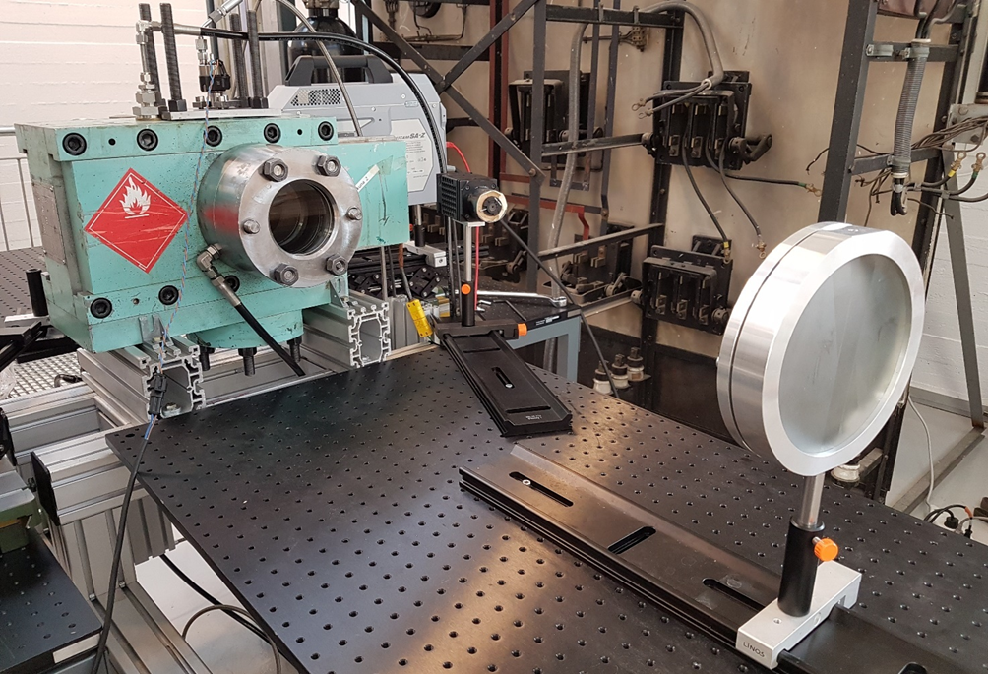
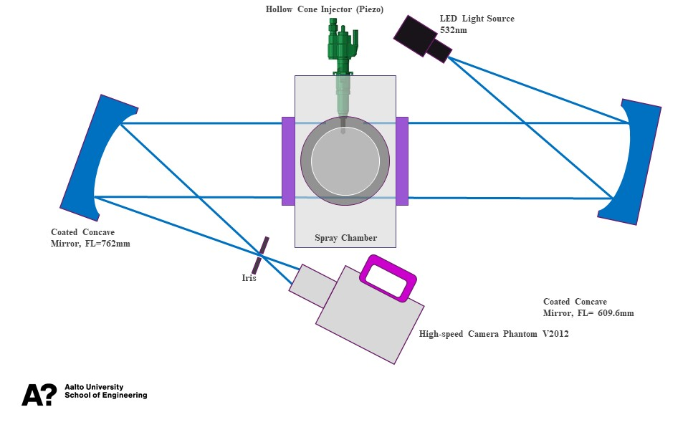
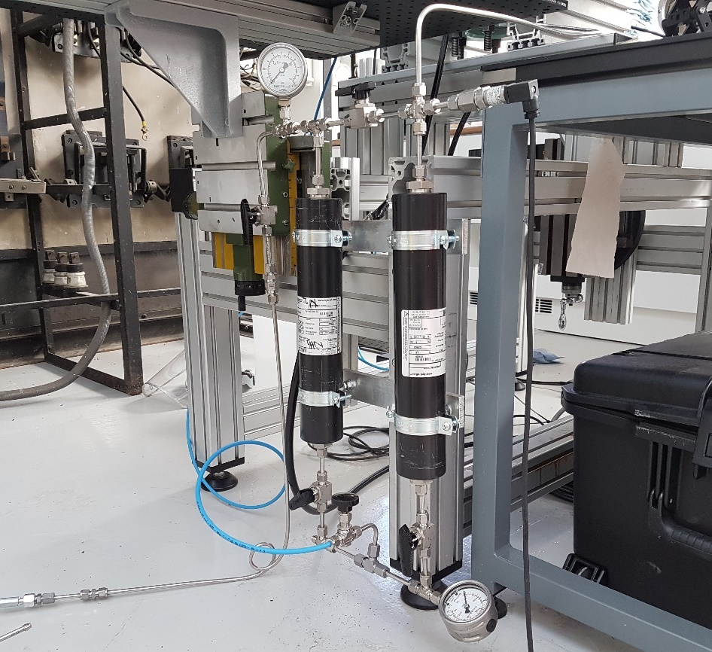
Research Group of Energy Conversion
Department of Mechanical Engineering
Aalto University, Finland
Flash Boiling Spray Diagnostics Using High-Speed Schlieren Imaging
Qiang Cheng (Jonny)
Flash Boiling Spray
Experimental Setup
Figure 1. Basic phase change of liquid fuels and flash boiling spray
High-Speed Schlieren Imaging
Figure 3. Schlieren setup at Aalto’s Engine Lab
Figure 2. Typical Z-type schlieren imaging
Descriptions of the High-Speed Schlieren Imaging
Figure 4. High-pressure fuel-system at Aalto’s Engine Lab
Schlieren imaging has been widely used in science and technology to investigate phenomena occurring in transparent media.
In particular, it has proven to be a powerful tool in fundamental studies and process optimization for liquid spray and gas jet diagnostics, providing qualitative and (in some cases) also quantitative information on the fluid-dynamic characteristics of liquid spray, evaporation and gas jet.
In this project, a typical Z-type schlieren will be used to visualize the phase change of the ammonia spray (or methanol and ethanol).
A high-speed camera will be adopted to capture the spray evolution from a multi-hole GDI injector.
A green LED light (532nm wavelength) as a light source will be used.
Two parabolic mirrors will be used to guide the light rays and generate the gradient in density and temperature.
Objective and Outcomes
You will learn how to use optical techniques to observe the phase change of some substances (e.g., ammonia, methanol and ethanol).
You will learn how to operate the fuel system and control system to control the fuel injection pressure and chamber pressure.
You have the opportunity to play the most advanced high-speed camera.
You will learn the basic method of image post-processing based on Matlab.
You will have a full map of how does the boundary conditions affect the spray phase change and spray geometry.
After the project, you will learn how to use academic ways to explain some phase change phenomena.
https://www.aalto.fi/en/department-of-mechanical-engineering/energy-conversion

